Slide 1
The Cloud for Modern Business
Sebastian Pederiva
sebastianp@sela.co.il
@spederiva

Slide 2
Why the cloud?
Notes:
Web applications have always been deployed on servers connected to what is now deemed the ‘cloud’.
With an on-premises datacenter you have to handle and manage everything
Responsible for maintaining it through its entire lifecycle

Slide 3
Why the cloud?
Rapidly setup environments to drive business priorities
Scale to meet peak demands
Increase daily activities, efficiency and reduced cost.
Speed
Scale
Economics
Notes:
Cloud provider is responsible for all the infrastructure
Improve agility and time to market by reducing or removing infrastructure barriers.
Increasing audience reach to new markets such as mobile devices.
Benefiting from the massive scale of cloud computing
Reducing costs (and improving efficiency) by more closely matching demand and capacity.

Slide 4
Pay only for what is used
There is no upfront cost
There is no need to buy any server licenses
If you use a SQL database, no need to buy a SQL Server license
For Virtual Machines and Web Sites, pay by the hour
Scale up and scale down your solutions – or even turn them on and off as necessary – cost is scaled appropriately, automatically
Evaluation period is no cost at all, of course – including this training
Notes:
We have a DATING SITE and publish an AD on Boca-Riber game
Pay only for what is used
Server – Per Hour
Bandwidth – Per Gigabyte
Storage – Per Gigabyte
CPU/Memory – Per unit
Emails – Per recipient

Slide 5
Why the cloud?
Hosting models
Business model
On Premises
Infrastructure
(as a Service)
Platform
(as a Service)
Software
(as a Service)
Applications
Applications
You manage
Applications
Applications
You scale, make resilient and manage
You scale, make
resilient & manage
Data
Data
Data
Data
Runtime
Runtime
Runtime
Runtime
Scale, resilience and management by vendor
Middleware
Middleware
Middleware
Scale, resilience and management by vendor
Middleware
O/S
O/S
O/S
O/S
Virtualization
Virtualization
Managed by vendor
Virtualization
Virtualization
Servers
Servers
Servers
Servers
Storage
Storage
Storage
Storage
Networking
Networking
Networking
Networking
Notes:
IaaS
Running virtualization software
Depending on the vendor, you can create a VM running Windows or Linux
Virtual networks, load balancers, and storage
The only thing you need to worry about is installing the operating system and configuring the server to suit your needs
We no longer need to worry about buying hardware and licenses
PaaS
Deploy your application into an application-hosting environment provided by the cloud service vendor
Focus strictly on development
Avoid spend time on your infrastructure
SaaS
SaaS is software that is centrally hosted and managed for the end customer
Office 365, Microsoft One Drive, Dropbox, WordPress, and Amazon Kindle.

Slide 6
Agenda
Iaas
App Services
Pass
Storage
Data Platform
Service Bus
HD Insight
Docker
HOL

Slide 7
Agenda
Iaas
App Services
Pass
Storage
HOL
Data Platform
Service Bus
HD Insight
Docker
HOL

Slide 8
Azure

Slide 9
20 regions worldwide in 2015
Azure footprint
Data Centers
Regional Partners
Notes:
Actually Azure
200 cloud services
600,000 servers per region
11 million-plus: The number of servers hosted in our datacenters.
$15 billion-plus: Microsoft’s investment in building our huge cloud infrastructure.
Speaker notes:
Broad global reach
Azure maintains a global presence across 17 datacenter around the world to help customers and partners meet their goal of providing applications close to their user base.
Mention contribution of regional partners help Azure’s global presence.
Microsoft's continued investment in subsea and terrestrial dark fiber capacity helping deliver data at higher speeds, with higher capacity and lower latency for our customers across the globe.
Use the following notes if you want to address some or all security, compliance, transparency and privacy concerns of the audience.
Microsoft has leveraged its decades-long experience in operating some of the world’s largest online services to create a robust set of security technologies and practices to keep your data at rest or in motion secured in Azure.
Azure meets a broad set of international and industry-specific compliance standards as part of help customer attain compliance for their own infrastructure running on the platform.
Azure is subjected to rigorous audits by independent organizations and the results are available to you as a part of Microsoft's commitment to transparency.
Azure adheres to stringent privacy policies through a program called Privacy by Design which describes Microsoft's core privacy concerns to protect customer data and how to address them. Those protections are then backed with strong contractual commitments to safeguard customer data with by abiding by the EU Model Clauses, Safe Harbor programs, and ISO/IEC 27018 (which governs the processing of personal information).

Slide 10
Datacenter buildings are about one football field in size

Slide 11
And there are 16 buildings per region…
That’s up to 600,000 servers in each Azure region
Notes:
600,000 servers per region
11 million-plus: The number of servers hosted in our datacenters.

Slide 12
>57%
More than
1,000,000
>300k
Fortune 500 using Azure
Active websites
SQL Databases in Azure
>30
>300
>1.65
TRILLION storage objects
MILLION
AAD users
>3
MILLION requests/sec
>13
BILLION
MILLION
authentication/wk
Developers registered with Visual Studio Online

Slide 13






















































Partners

Slide 14
Portal
Storage
ASP.NET MVC 5.1
Virtual Machines
SMB File System
Traffic Mgr
Disk Optimized
Memory Optimized
IBIZA
Azure Redis Cache
Hadoop 2.2
Powershell and DSC
Static IP
Resource Manager
99.95% SLA
Puppet Chef Docker
Event Hub
2014
Subnet Routing
Backup
Capture / Deploy
.NET 4.5
Web Apps
SQL Database
Powershell Automation
BD’s up to 500GB
Cordova
API Management
.NET Support
Autoscale
Active GEO replication
Node.JS project support
Self Service Site Recovery
Java Support
Remote Apps
Visual Studio & .NET
Networking
ASP.NET Web API 2.1
Web Jobs
Point-to-site VPN
Xamarin
Mobile Services
Remote Debug
VSO Open Api’s
Offline Sync
Dynamic Routing
HDInsight
AD support
VSO GA
VM Management
Kindle Support
Autoscale
Remote Debugging
Site Recovery
YARN support
.NET Foundation

Slide 15
How we differentiate with Azure
Hyper-scale
Enterprise Grade
Hybrid

Slide 16
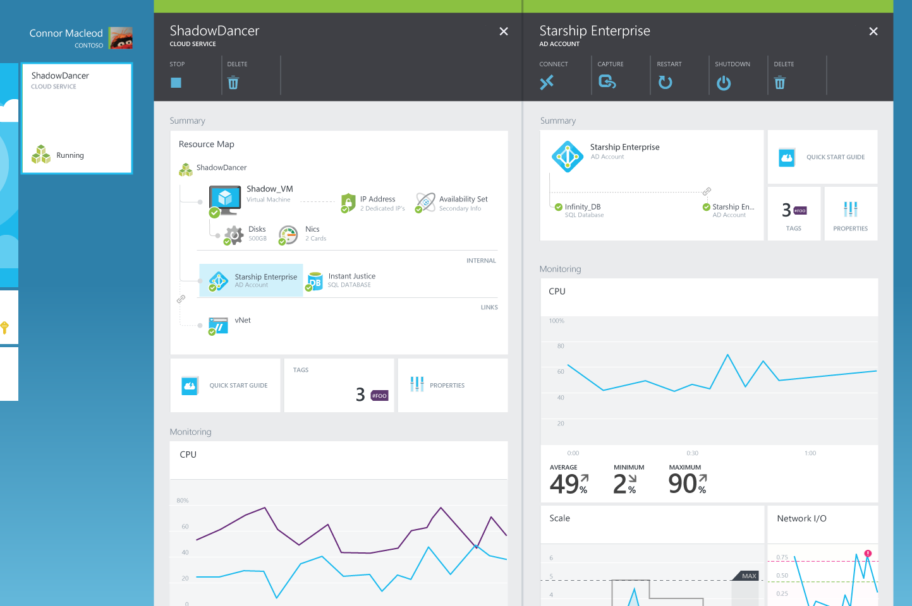
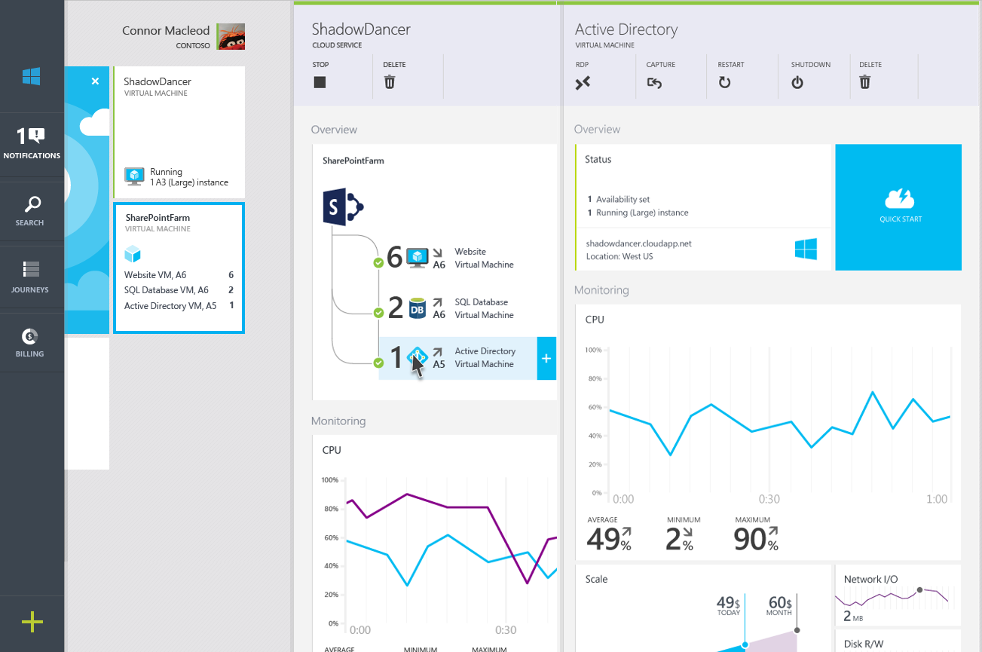
Hybrid consistency
CUSTOMER DATACENTER
CONSISTENT PLATFORM
MICROSOFT AZURE
SERVICE PROVIDER
Common OS and Hypervisor
Common management API/UX
Common programming model

Slide 17

Connect every on-premises server to the cloud
Azure
StorSimple
Backup
Hyper-V Disaster Recovery
VMWare Disaster Recovery
SQL Server Always On
Active Directory
Orchestration as a Service
ExpressRoute Networking
On-Premises Datacenter

Slide 18



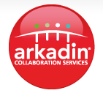


























































Cloud OS Network hosting and service providers

Slide 19









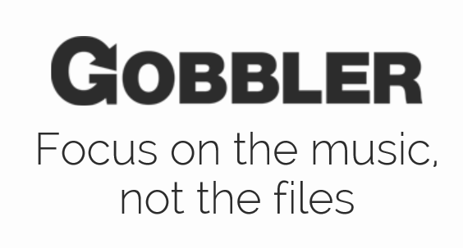




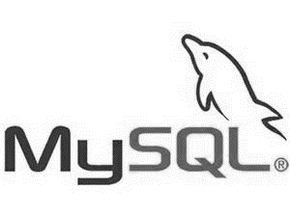
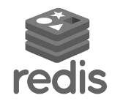







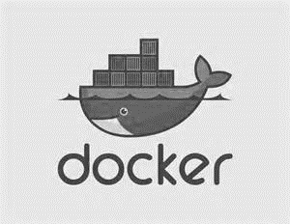
Support for Open Source
Languages
CMS
Devices
Databases / Apps
Operating
systems
Management

Slide 20
Trust through Transparency
$
Monthly SLAs
ISO 27001 Cloud Security Alliance (STAR)
Industry standards
Regulatory compliance
Trust center
Yearly audits
Independently verified
Real-time status
Service dashboard
HIPAA Business Associate Agreement (BAA)

Slide 21





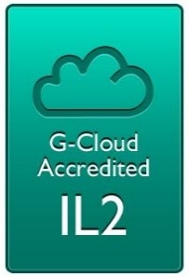

Compliance: aka.ms/AzureCompliance
Notes:
Azure meets a broad set of international and industry-specific compliance standards, such as ISO 27001, HIPAA, FedRAMP, SOC 1 and SOC 2, as well as country-specific standards including Australia IRAP, UK G-Cloud, and Singapore MTCS.
Azure cloud services, with independently verified compliance, give you the foundation to achieve compliance for the infrastructure and applications you run in Azure.
Azure is subjected to rigorous audits by independent organizations and the results are available to you as a part of Microsoft's commitment to transparency.
Microsoft was also the first to adopt the uniform international code of practice for cloud privacy, ISO/IEC 27018, which governs the processing of personal information by cloud service providers.

Slide 22
Azure Services

Slide 23







Microsoft Azure Services
Office Add-in
PC
Tablet
Phone
Browser
Games console
On-premises service
On-premises database
Client layer
(on-premises)
Access Control
Layer
AD
Multifactor
Authentication
BizTalk Services
Service Bus
Logic Apps
Traffic Manager
Virtual Networks
Express Route
CDN
Integration
Layer
API Mgmt
Mobile Apps
Web Apps
API Apps
VM
Media Services
Notification Hubs
Scheduler
Automation
Cloud Services
Application
Layer
Blobs
Tables
Queues
SQL Database
Machine Learning
HD Insight
Caching
Backup and Recovery
StorSimple
Data Layer
Storage
Data
Notes:
MongoDB/MongoLab
Text Analytics
MySQL Database - ClearDB
Face APIs
Facetflow Elasticsearch
New Relic
RavenDB
SendGrid

Slide 24

























Microsoft Azure Services
Visual Studio Online
Application Insights
Scheduler
Automation
Operational Insights
Key Vault
…
Developer
Services
Management
Marketplace
HDInsight
Machine Learning
Stream Analytics
Data Factory
Event Hubs
BizTalk Services
Service Bus
Backup
Site Recovery
Media Services
Analytics
& IoT
Hybrid
Integration
Media & CDN
App
Service
API Management
Notification Hubs
Mobile Engagement
Azure Active Directory
Multi-Factor Authent
CDN
Web
& Mobile
Identity
& Access
Web App
Mobile App
API App
Logic App
Virtual Machines
Cloud Services
Batch
Service Fabric
RemoteApp
Virtual Network
ExpressRoute
Traffic Manager
DNS
Application Gateway
Compute
Networking
Storage
SQL Database
Search
DocumentDB
Redis Cache
StorSimple
Data Lake
Data Warehouse
Data
& Storage
Blobs
Tables
Queues
Files
Notes:
MongoDB/MongoLab
Text Analytics
MySQL Database - ClearDB
Face APIs
Facetflow Elasticsearch
New Relic
RavenDB
SendGrid

Slide 25
Demo: Azure Portal

Slide 26
Virtual Machines
Getting started
Select image and VM size
New disk persisted in storage
Management portal
Windows Server
Boot VM from new disk
>_
Linux
Scripting
(Windows, Linux and Mac)
Blob Storage
General Purpose
Basic
Standard
Optimized Compute
Performance Optimized
Network Optimized
REST API
Cloud
Comprehensive
Networking

Slide 27
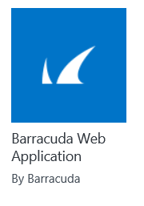
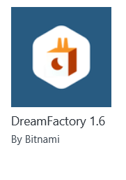
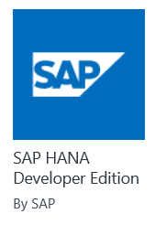
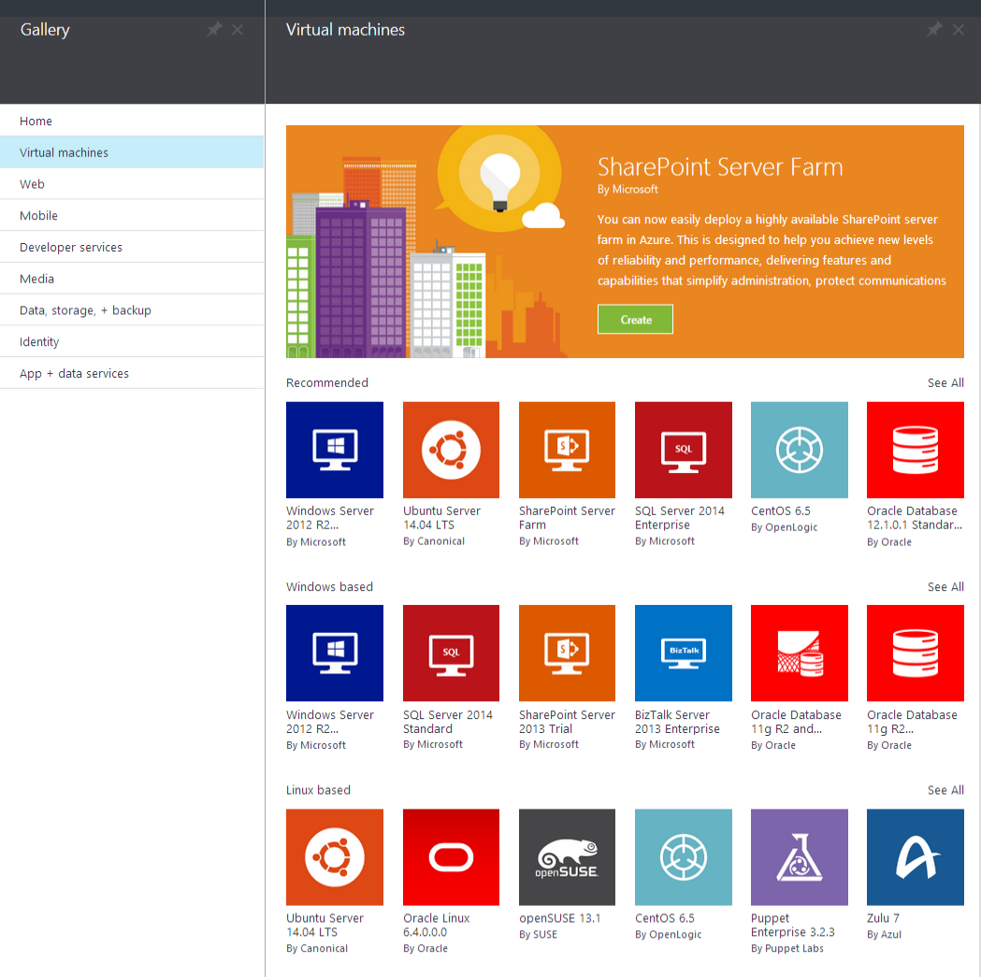

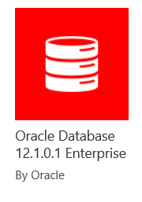
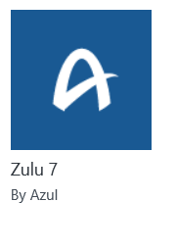
Microsoft Azure
Certified

Slide 28

Microsoft Azure Site Recovery Orchestrated disaster recovery to a second site or to Azure
Microsoft Azure Site Recovery
Microsoft Azure Site Recovery
Communication Channel
Communication and Replication
Replication channel: Hyper-V Replica
Windows Server
Primary Site
Recovery Site
Windows Server
Primary Site
Windows Server
Automated VM protection and replication
Remote health monitoring
Customizable recovery plans
No-impact recovery plan testing
Orchestrated recovery when needed

Slide 29

Titanfall
→ Game sessions hosted using Azure
→ Hosted using >100,000 Azure Virtual Machines
Notes:
Points to land:
Imagine what you could do…
→ 360,000 concurrent cores
→ Have EA tell the story
→ Assume we don't run out of capacity

Slide 30


SQL Database
Fully managed SQL Server database technology as a service
Ideal for simple and complex applications
Enterprise-ready with automatic support for HA
Secondary
Replica
Primary
Secondary
Replica
Secondary
Replica
Notes:
How is HA achieved?
At any one time, three database replicas are running—one primary replica and two or more secondary replicas
If the hardware fails on the primary replica, Azure SQL Database detects the failure and fails over to the secondary replica.
In case of a physical loss of a replica, a new replica is automatically created. So there are always at minimum two physical, transitionally consistent copies of your data in the datacenter.

Slide 31
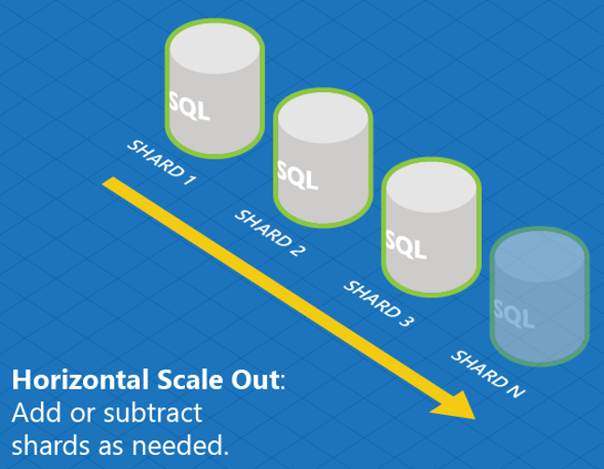
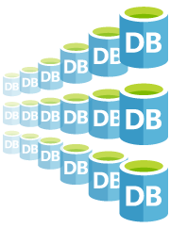
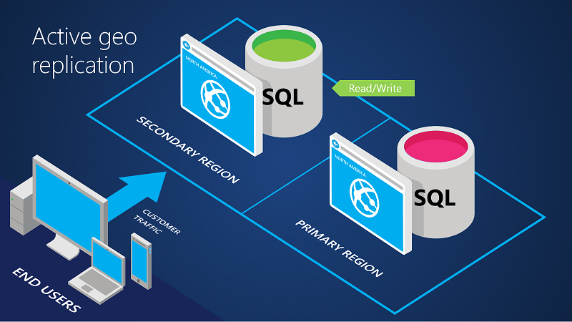
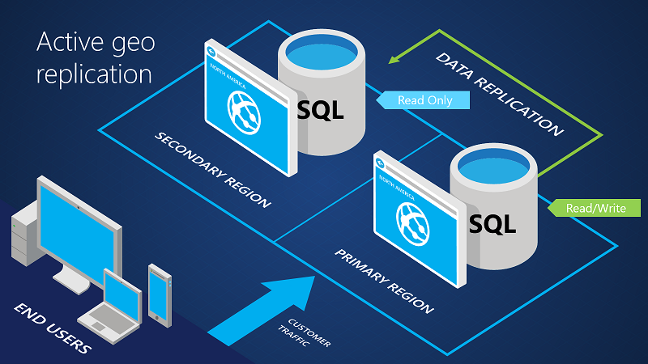
SQL Database
Designed to scale out elastically with demand
Robust Failover and Disaster Recovery capabilities
Cross Datacenter Failover
Notes:
Speaker notes:
Azure SQL Database Elastic Scale capabilities simplify the process of scaling out (and in) a cloud application’s data tier by streamlining development and management. Based on industry-standard sharding practices, Elastic Scale offers functionality to help you build and maintain applications that can span a few databases or thousands.
On top of the built-in systems that enable HA of your database, Azure SQL Database offers additional business continuity features:
The active geo-replication support enables you to initiate/control any failovers – allowing you to shift the primary database to any of your secondary regions.
The built-in backup and restore capabilities offered by Azure SQL Database provide great functionality for recovering from disaster and human error (oops mistakes).

Slide 32
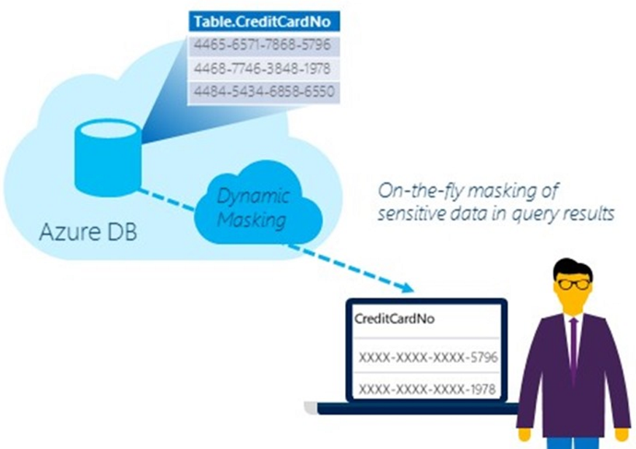
SQL Database
Compliant with industry regulations and policies
Secured Encrypted Database Files
Limit exposure of sensitive data
Protect Sensitive Data
Notes:
Speaker notes:
Transparent Data Encryption (TDE) is used to encrypting a customer’s Azure SQL database at rest in real-time to help protect against the threat of malicious activity. In a scenario where the physical media (such as drives or backup tapes) are stolen, a malicious party can’t restore or attach the database and browse the data without the encryption keys.
Limit the exposure of sensitive data in Azure SQL Database using Dynamic Data Masking to meet industry compliance policies.

Slide 33
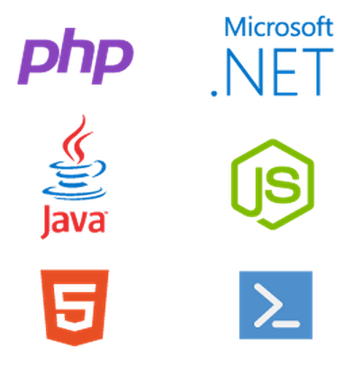
SQL Database
Full support for TDS and ODBC
Familiar language and framework support
Notes:
Speaker Notes:
Microsoft Azure SQL Database supports tabular data stream (TDS) protocol client version 7.3 or later. Earlier versions of TDS protocol are not supported.
You can use Configuring ODBC Data Sources to define user and system data sources for Microsoft Azure SQL Database.
Drive productivity through support for familiar functionality, tools and platforms

Slide 34

Big Data Insights
Microsoft Azure HDInsight
Microsoft instance of Hadoop distribution running as service
Support existing ecosystem from Hive, Pig, etc
Includes HBase and Storm
Extended to support Excel and BI tooling
Integration with diverse sources of data
Notes:
HDInsight is Microsoft instance of Apache Hadoop distribution running as a service in Azure cloud that you can spin up in minutes.
It’s architected to handle any amount of data, scaling from terabytes to petabytes on demand.
Supports existing ecosystem such as Hive to explore your data or to create reusable batch processing jobs.
Processing and analyzing structured or semi-structured data from web clickstreams, social media, server logs, devices and sensors, and more.
Integrated with Excel
Leverage existing skills for configuration, submission, and monitoring of Hadoop jobs using languages you know such as Java, C#, PowerShell, .Net SDK

Slide 35
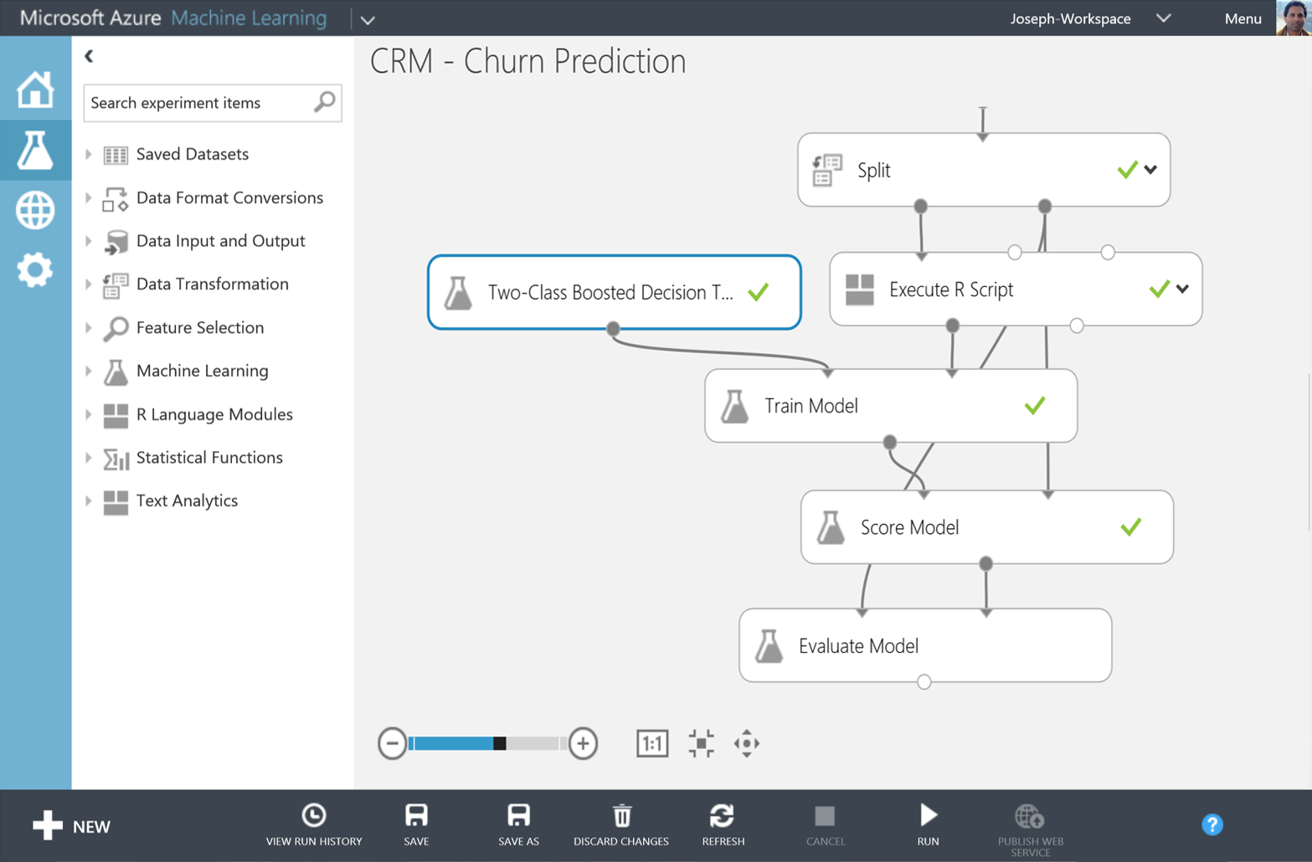
Big Data Insights
Microsoft Azure Machine Learning
Democratized platform for Machine Learning
Fully-managed cloud service for building predictive
analytics solutions
Elastic, pay as you go with low operating costs
Extend with Power BI, HDInsight and cloud hosted data
Extensible, supports R and Python
Notes:
Speaker notes:
Democratized; Azure Machine Learning lets the masses and scientists alike learn, experiment, mashup and create high quality powerful algorithms.
Visually compose ML workflow through a web browser with no software to install and without learning multiple tools from data acquisition, cleaning and prep, machine learning, and experimentation.
Fully-managed cloud service for building predictive analytics solutions, helps overcome the challenges most businesses have in deploying and using machine learning.
Enables data scientists and developers to efficiently embed predictive analytics into their applications.
Azure ML is supports today’s Data scientists’ choice of language R and can bring their existing assets in R and integrate them seamlessly into Azure ML workflows.

Slide 36

Azure App Service
Web Apps
Mobile Apps
Web apps that scale with your business
Build Mobile apps for any device
LOGIC Apps
Api Apps
Automate business process across SaaS and on-premises
Easily build and consume APIs in the cloud
Notes:
App Service has everything you need to build apps that target both web and mobile clients from a single app back-end.
Using API Apps, you can connect your app to dozens of popular services like Office 365 and salesforce.com in minutes, and integrate your own APIs so they can be used within any app.
And finally with Logic Apps, you can automate business processes using a simple no-code experience.

Slide 37
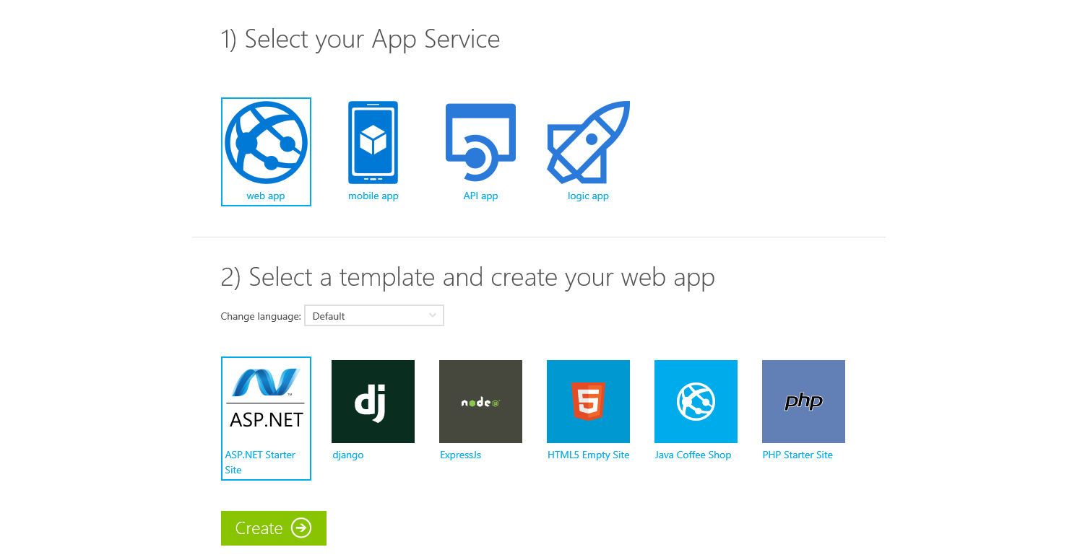
Try App Service Today
https://tryappservice.azure.com
Free
No Signup or Account Required

Slide 38



Azure App Service Web Apps
Start simple
Code smart
Go live
Easily create and scale your new sites in seconds
Automatically scale your sites that scale with your business
Quickly improve performance and reduce latency with right resources
Built-in web jobs support
Leverage existing skills – Languages and databases you know
Start with open source apps and frameworks
Develop with VS and WebMatrix
Supports X-Plat development
Improve developer productivity through continuous automated deployment
Built-in monitoring of perf and usage data
Built-in diagnostics to assist with debugging
Built for DevOps
Office Blog ASP.NET site microsoft.com
Notes:
Start simple
Emphasize rapid deployment of Web Apps from choice of Asp.Net starter applications to thousands of pre-built certified, opensource, and community software applications, add-ons, and data analysis platforms pre-configured for Azure.
Explain how Web Apps use automatic load balancing to scale out.
With Web Apps its easy to scale out automatically with increasing instance count using autoscale features e.g. CPU Load, scheduled
Easily improve performance of Web Apps and reduce latency of by changing to right instance size with zero downtime
Supports cron jobs
Code smart
Leverage existing skills to start coding for Web Apps without expensive retraining:
Languages: .NET, Java, NodeJS, PHP, Python. Databases: SQL Server, MySql .
Start coding with any development tools on any platforms such as Linux, OSX and Windows.
Go live
Built for DevOps – Agility through continuous deployment.
Encourages iterative development and improves developer productivity through continuous automated deployment enabled by Web Apps’ integrated source control connectivity to Team Foundation Server(TFS) and Git.
Easily monitor key performance metrics in a verbose or minimal fashion. Easily access monitoring data from a storage account externally for further analysis.
Easily enable diagnostics logging and add instrumentation. Easy access to information logged.

Slide 39
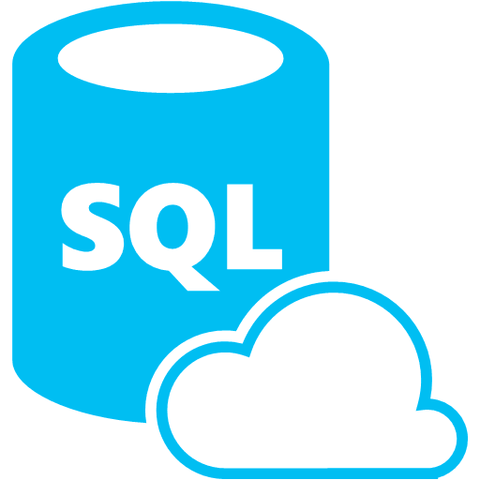






Azure App Service Mobile Apps
Provides essential services to support client development
Client Support
iOS
Android
HTML5/Web
Xamarin
Windows
Windows Phone
PhoneGap
Sencha
Storage
Authentication
Logic
Push
Scheduler
Notes:
Azure Mobile Services is a Backend-as-a-Service
Instead of you having to design, build, test, deploy, manage, and upgrade your whole backend, we do it for you
Features of Mobile Services
Storage – SQL DB
Authentication – built in support for social providers w/ ability to custom auth
Backend logic – data validation, logical flows, etc
Push Notifications – across all major mobile platforms
Scheduler – backend job processing

Slide 40
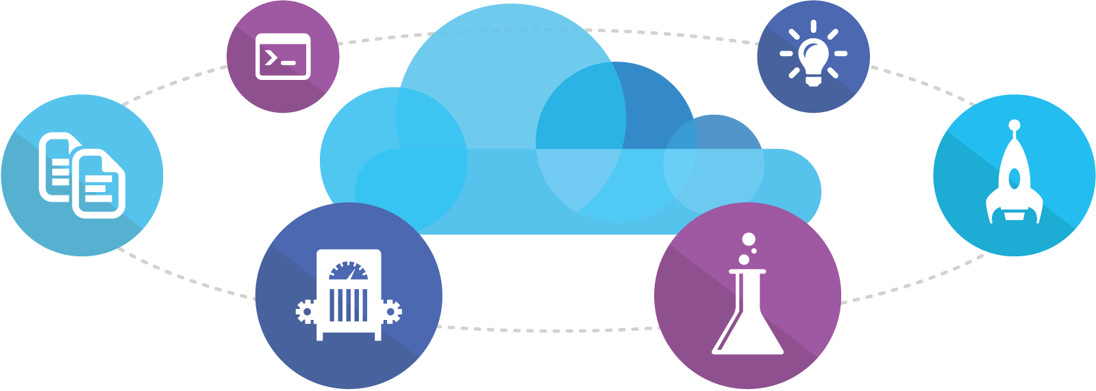
Visual Studio Online
Code
Insights
Agile
Deploy
Build
Test
Full Portal Integration
Not just for Microsoft shops

Slide 41
Demo: Azure Preview Portal

Slide 42
You
Microsoft Azure Active Directory
Synchronize your corporate and 3rd party identities
Integration with O365
Support modern protocols
OAuth 2.0
OpenID Connect
WS-Fed
SAML 2.0
Identity and Access Mgmt Permissions
Users
Groups
Applications
Microsoft Azure AD
3rd party clouds/hosting
PCs and devices

Slide 43

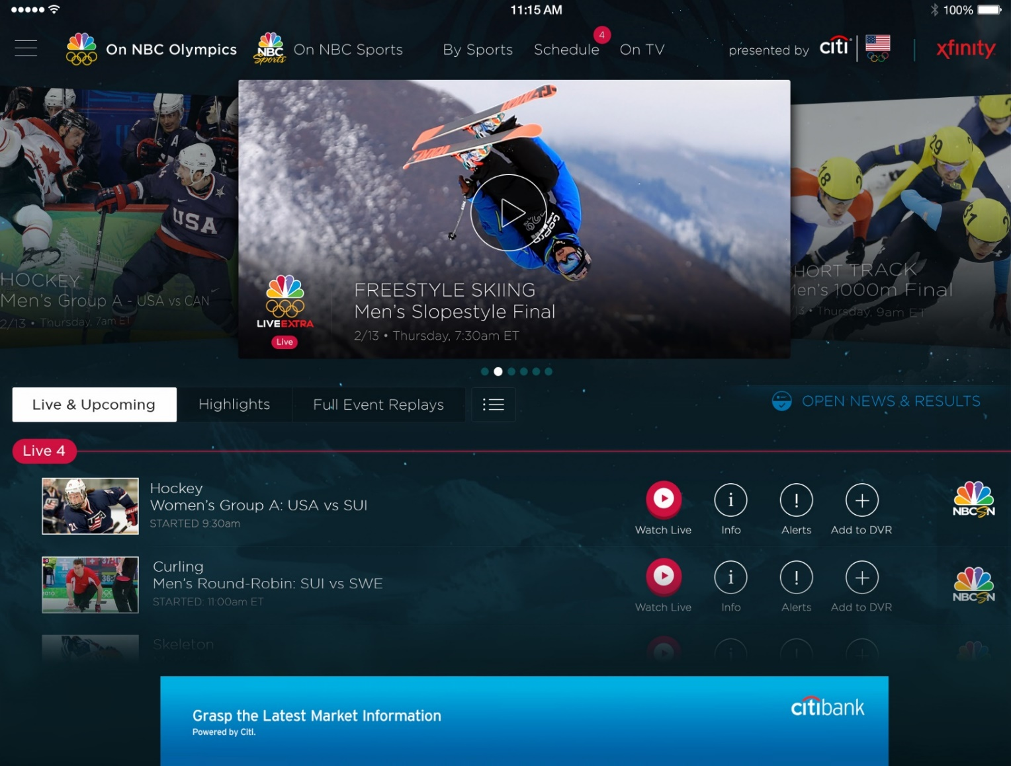
Azure Media Services
Olympics NBC Sports
On Demand Media Services
Video-on-demand
Ingest
Encode
Package
Encrypt
Delivery
Live Streaming Support
Office 365 Integration
Azure Media Player
Live video encoding and streaming
Web + Mobile
100 million viewers
2.1 million concurrent HD viewers during the USA vs. Canada hockey match
Notes:
Speaker notes:
Deliver video content or stream video to audiences large or small to any device(Web or Mobile) anywhere reliably and in scale.
Helps you create versatile media workflows for ingesting, encoding, protecting and streaming content to audiences on-demand or broadcast live.
Powerful and extensible platform with broad set of first and third-party capabilities to support complete end-to-end media workflows.
Integration with Office 365 empowers organizations of all sizes helps to use videos to enhance sharing, collaboration and communication.
Azure Media Player, an automated online player solution, supports all the usual industry standards like HTML5 video, Media Source Extensions and rights management through Encrypted Media Extensions. The focus here is on open standards, but on older browsers, the player can fall back on Flash or Silverlight.

Slide 44

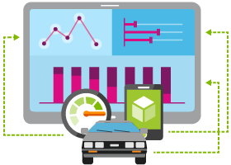





Internet of Things
Event Hubs
Notification Hubs
Stream Analytics
Machine Learning
HDInsight
Power BI for Office 365
With Microsoft Azure IoT services, you can monitor assets to improve efficiencies, drive operational performance to enable innovation, and leverage advance data analytics to transform your company with new business models and revenue streams.
Notes:
Azure Mobile Services is a Backend-as-a-Service
Instead of you having to design, build, test, deploy, manage, and upgrade your whole backend, we do it for you
Features of Mobile Services
Storage – SQL DB
Authentication – built in support for social providers w/ ability to custom auth
Backend logic – data validation, logical flows, etc
Push Notifications – across all major mobile platforms
Scheduler – backend job processing

Slide 45
Azure Data Factory
Compose and orchestrate
Connect to data of diverse shapes and location
Orchestrate processing to produce trusted data
Manage from single pane of glass
Manage a network of data pipelines
See lineage and impact analysis
Set data production policy
Retry, concurrency, late data handling
Identify and debug errors
Automatic dataset health alerts
Troubleshoot complex pipelines
AZURE DATA FACTORY
Manage and monitor
Data and operational lineage
Coordination and scheduling
Policy
DATA PIPELINES
Activity
Activity

Slide 46

Azure Stream Analytics
Event producers
Collection
Ingestor (broker)
Transformation
Long-term storage
Presentation and action
Stream Analytics
Web/thick client dashboards
Applications
Service bus
Legacy IOT (custom protocols)
Event hubs
Azure DBs
Stream processing
Search and query
Devices
Cloud gateways (web APIs)
Azure storage
IP-capable devices (Windows/Linux)
Storage adapters
HDInsight
Data analytics (Excel)
Low-power devices (RTOS)
Field gateways
Devices to take action

Slide 47
Azure Service Fabric
Rapidly develop microservice based applications
Operate reliable, scalable services
Enjoy the confidence of a battle-tested platform
Stateless or Stateful
Visual Studio tools
Focus on features not infrastructure
Rolling upgrades
Automatic Orchestration
Hybrid Operation
Self-Healing
Self-sufficient
Comprehensive
The same technology Microsoft uses
Proven more than 5 years
Investment & Roadmap

Slide 48
Key Scenarios to Get Started with Microsoft Azure

Slide 49



Key Scenarios to get started with Microsoft Azure
Full Dev/Test environments
Build
Production
Visual Studio Online
Master branch
GIT / TFS
Staging
Check-in
Test branch
Dev/Test
Developers
Notes:
Create full Dev, Test, Staging and Production environments in minutes
Availability of Visual Studio Online(VSO) integration with build option available
Validate web app changes in a staging or test deployment slot before swapping it with the production slot
Swap to get your "last known good site" instantaneously if there is a problem with a new deployment in production
Swapping to production from staging as opposed to direct deployment eliminates downtime
Dev, Test, Staging and Production deployment workflow can be automated when pre-swap validation isn’t needed

Slide 50




Key Scenarios to get started with Microsoft Azure
Microsoft SQL Server
VM
Microsoft SQL Server
VM
Microsoft Azure
Lift and Shift
Application VM
Storage
Corporate
Network
Application VM
Archive
key data inexpensively
PDF
JPG
VIDEO
DB
DOCX
Notes:
Lift and Shift
Take existing work loads and run them in a certified instance.
Emphasize image mobility and Azure Files to help move applications that require SMB shared folders very easily to Azure.
Storage
Archive key data in inexpensive cloud storage. Mention corporate finance databases, industry compliance documents and other key data can be inexpensively archived to Azure storage.

Slide 51


Key Scenarios to get started with Microsoft Azure
HDInsight
Visualization
and reporting
tools
Input
Process
Results
Output
Iterative exploration - Process key data into business intelligence using Hadoop
Notes:
Speaker notes:
Iterative exploration
The source data files(log files, email messages, tweets, and more) are loaded into the cluster, processed by one or more queries within HDInsight, and the output is consumed by the chosen reporting and visualization tools. The cycle repeats using the same data until useful insights have been found, or it becomes clear that there is no useful information available from the data—in which case you might choose to restart the process with a different source dataset.

Slide 52
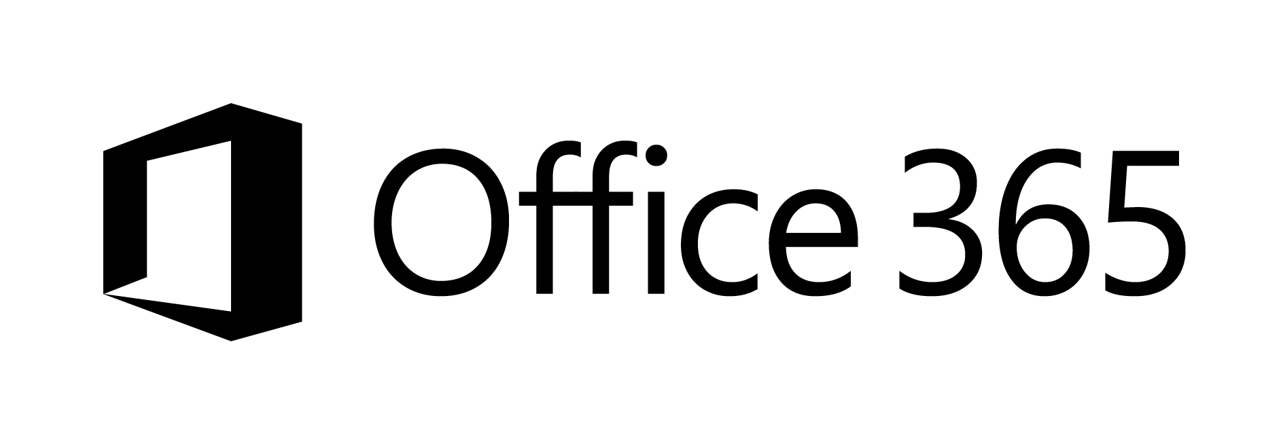





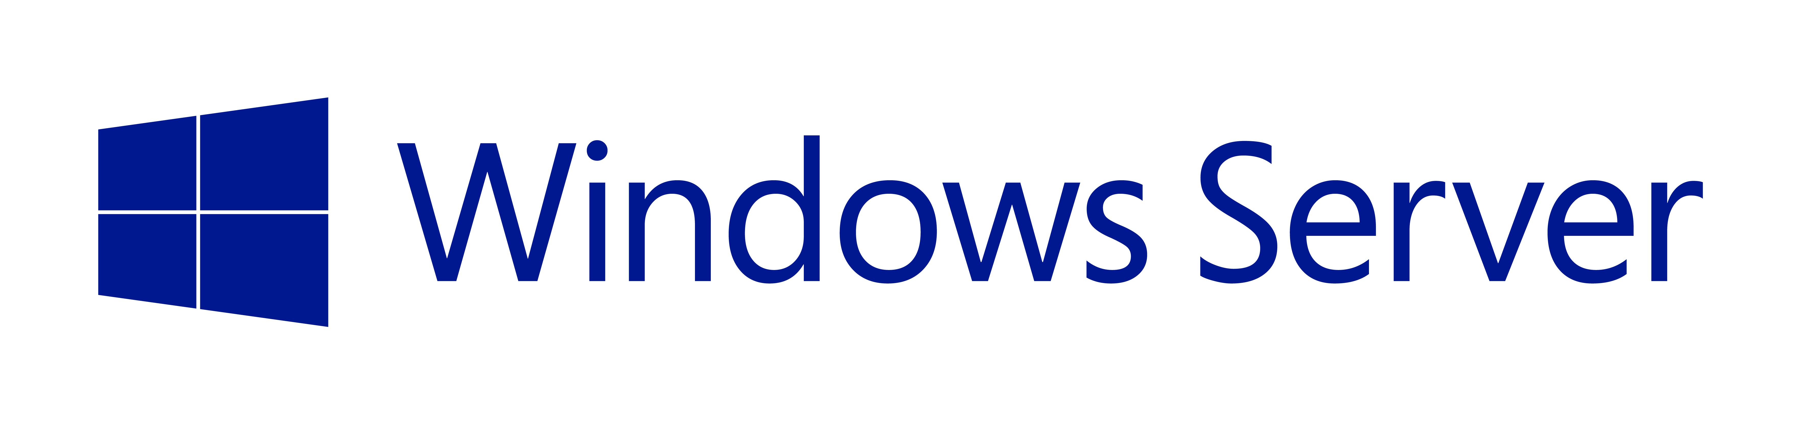

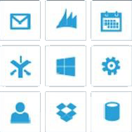
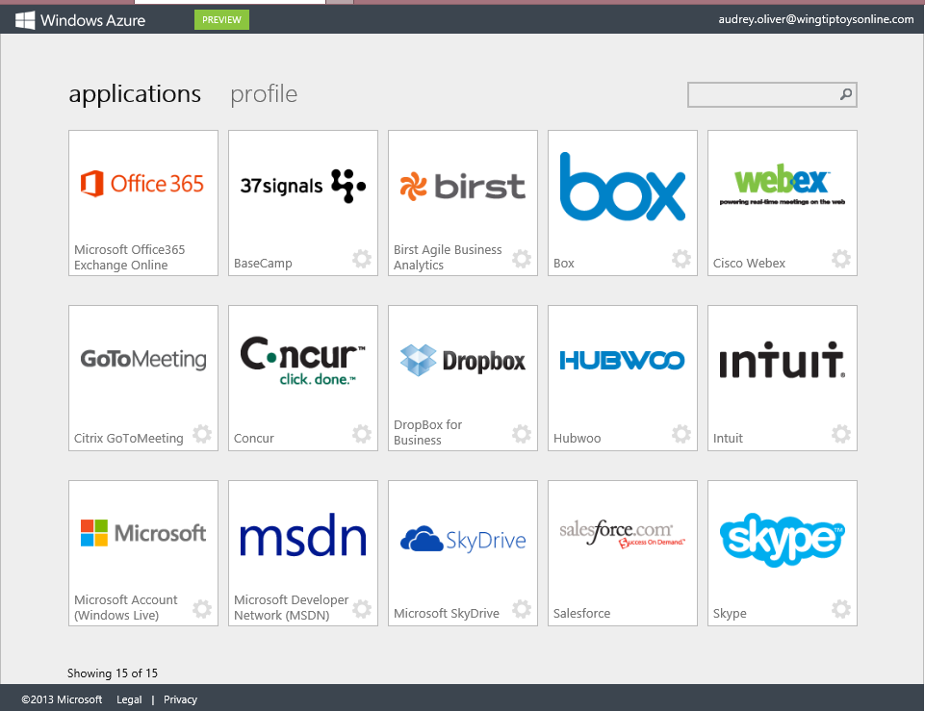
Key Scenarios to get started with Microsoft Azure
Identity as a Service
SaaS
Active Directory
Active Directory
Synchronize and
consolidate
identities
Custom LOB apps
ISV/CSV apps
Azure App Service and Non-MS cloud-based apps
PCs and devices
Notes:
Speaker notes:
Identity as a Service; Control and protect your apps, data and services in Azure together with assets in non-MS cloud using a single AD account.
Consolidate all your identities using one account for single sign-on to any cloud and on-premises services, using your favorite device, including iOS, Mac OS X, Android, and Windows devices.
As a developer you must also need to understand implications of extending your credentials in on-premises Active Directory to Azure Active Directory to protect your assets in on-premises and in the cloud.

Slide 53



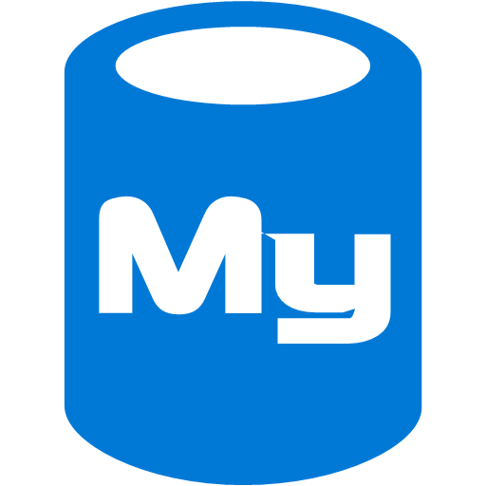



On-premises /
Hosting Services
IIS/SQL Server Based
Web Apps
Microsoft
SQL
Server
IIS
Non-IIS Open Source
Web Apps
Microsoft Azure
MySql
Web Apps - Take your web apps to the cloud using inexpensive App Service Web Apps
Key Scenarios to get started with Microsoft Azure
Notes:
Speaker notes:
You can easily move your existing IIS based web apps including SQL Server databases to Azure App Service easily with a migration tool provided by Microsoft called Azure App Service Migration Assistant.
If your open source web app’s framework is supported on App Service, the languages and frameworks needed by your application are configured for you automatically. Migrate an existing application or create a new one from the Application Gallery.
Consider using Azure Cloud Services or IaaS Virtual Machines if you are unable to migrate your application via Migration Assistant or your open source web app’s framework isn’t supported on App Service.
Other notes:
Windows Server 2003 will reach end of support on July 14th 2015. If you are currently hosting your websites on an IIS server that is Windows Server 2003, Web Apps is a low-risk, low-cost, and low-friction way to keep your websites online, and Web Apps Migration Assistant can help automate the migration process for you.
Moving to Web Apps require less time and IT expertise to configure and secure your apps compared to apps running in VM environment.
Web Apps require no maintenance effort on your part to patch, update, and manage underlying VM environment.

Slide 54
Activate your MSDN Benefits…
+
3 VMs for 16 hrs a day
80 VMs for 20 hour load test
Up to 100 web sites + DB
Up to
$150
33%^{off}
25%^{off}
89
per Month
Dev/Test VMs
Other Dev/Test
Countries

Slide 55
Get started today at http://azure.microsoft.com

